Slide 1
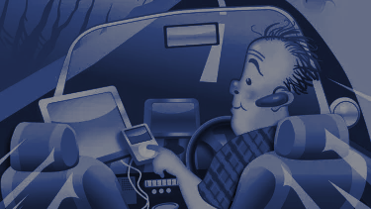
Pile -Up Shielding
Notes:
Good morning everyone.
Let me briefly introduce myself. My name is “Disha Gupta” and I am delighted to be here today to talk to you about our project which is Pile up Shielding

Slide 2
Team Members :-
Supervisor :-
Dr. Deepak Kumar Singh
Disha Gupta (LIT2018026)
Saakshi Jain (LIT2018075)
GROUP 15
Notes:
We want to say thanks to Deepak sir for supervising us. We appreciate all the knowledge and skills he has imparted to us.
Our presentation is divided into 2 section, First one is covered by me (Disha Gupta) and other by my Team mATE saakshi jain.

Slide 3
Driving a car is a complex task, and it requires complete attention. Distracted driving is any activity that takes away the driver’s attention from the road.
This project (Pile-up shielding) aims to recognize unsafe behaviour and send real time feedback to the driver using short sound alert etc.The system can be used to classify the behaviour of a driver via live video feed.
Notes:
As we are all aware,Driving a car is a complex task, and it requires complete attention. Distracted driving is any activity that takes away the driver’s attention from the road. This project (Pile-up shielding) aims to recognize unsafe behaviour and send real time feedback to the driver using short sound alert etc.The system can be used to classify the behaviour of a driver via live video feed.

Slide 4
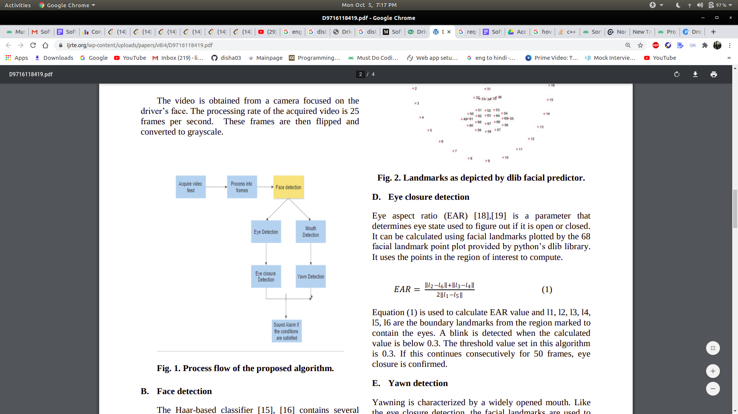
Process flow of the proposed algorithm -
To overcome the problem, came up with the solution implemented using OpenCV, DLib and other open source libraries . Python is used as a language to implement the idea.
A web camera is used to continuously track the facial landmark and movement of eyes and lips of the driver. This project mainly targets the landmarks of lips and eyes of the driver. For detection of drowsiness, landmarks of eyes are tracked continuously. If the driver is found to be distracted then a voice (audio) alert is provided and a message is displayed on the screen.
Notes:
Now if I want to talk about Process flow of the proposed algorithm -
To overcome the problem, came up with the solution implemented using OpenCV, DLib and other open source libraries . Python is used as a language to implement the idea.The video is obtained from a camera focused on the driver’s face. The processing rate of the acquired video is 30 frames per second. These frames are then flipped and converted to grayscale. Then it detects face , if face is detected then it detects mouth and eyes of the driver, if everthing go well and any ditracted activity is distracted then sound or alart is produced

Slide 5
Requirement Specification:
The code of this system has written in python mainly. For the smooth functioning of this system, some libraries like Opencv,scipy,imutils ,dlibs etc and software must be there in the user Operating system priorly.
Run :
Python3 name_of_your_file.py -- webcam
//For external webcam, use the webcam number accordingly
Setups :
Change the threshold values according to your need
EYE_AR_THRESH = 0.3, EYE_AR_CONSEC_FRAMES = 30
YAWN_THRESH = 10` //change this according to the distance from the camera
Notes:
The code of this system has written in python mainly. For the smooth functioning of this system, some libraries like Opencv,scipy,imutils ,dlibs and software like espeak must be there in the user Operating system priorly.
To Run this function we need to type the command on terminal or any shell or software which we are using:
Python3 drowsiness_yawn.py (we save it as drowsiness_yawn.py) -- webcam
//For external webcam, use the webcam number accordingly

Slide 6
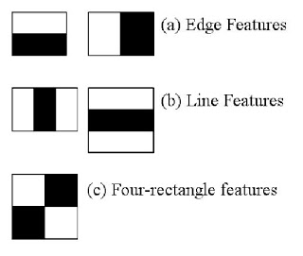
Haar Cascade
Object and Face Detection using Haar feature-based cascade classifiers is an effective object detection method proposed by Paul Viola and Michael Jones in their paper, “Rapid Object Detection using a Boosted Cascade of Simple Features” in 2001.
It is a machine learning based approach where a cascade function is trained from a lot of positive and negative images.
The algorithm has four stages:
Haar Feature Selection
Creating Integral Images
Adaboost Training
Cascading Classifiers

Slide 7
Scipy-
SciPy stands for Scientific Python. SciPy is a scientific computation library that uses NumPy underneath. It provides more utility functions for optimization, stats and signal processing.
Imutils-
Series of convenience functions to make basic image processing functions such as translation, rotation, resizing, skeletonization, and displaying Matplotlib images easier with OpenCV and Python.
OpenCV
Open Source Computer Vision Library is an open source computer vision and machine learning software library. OpenCV was built to provide a common infrastructure for computer vision applications and to accelerate the use of machine perception in the commercial products.
Using OpenCV, we can read an image, display it and after we are done with our operations for the day, save it.
Notes:
Now we draw bounding box and text prediction with cv2.rectangle() and cv2.putText() on our frame.
cv2.imshow-Now we are displaying frame on the screen and at the end of code stopping the stream and closing stream window:

Slide 8
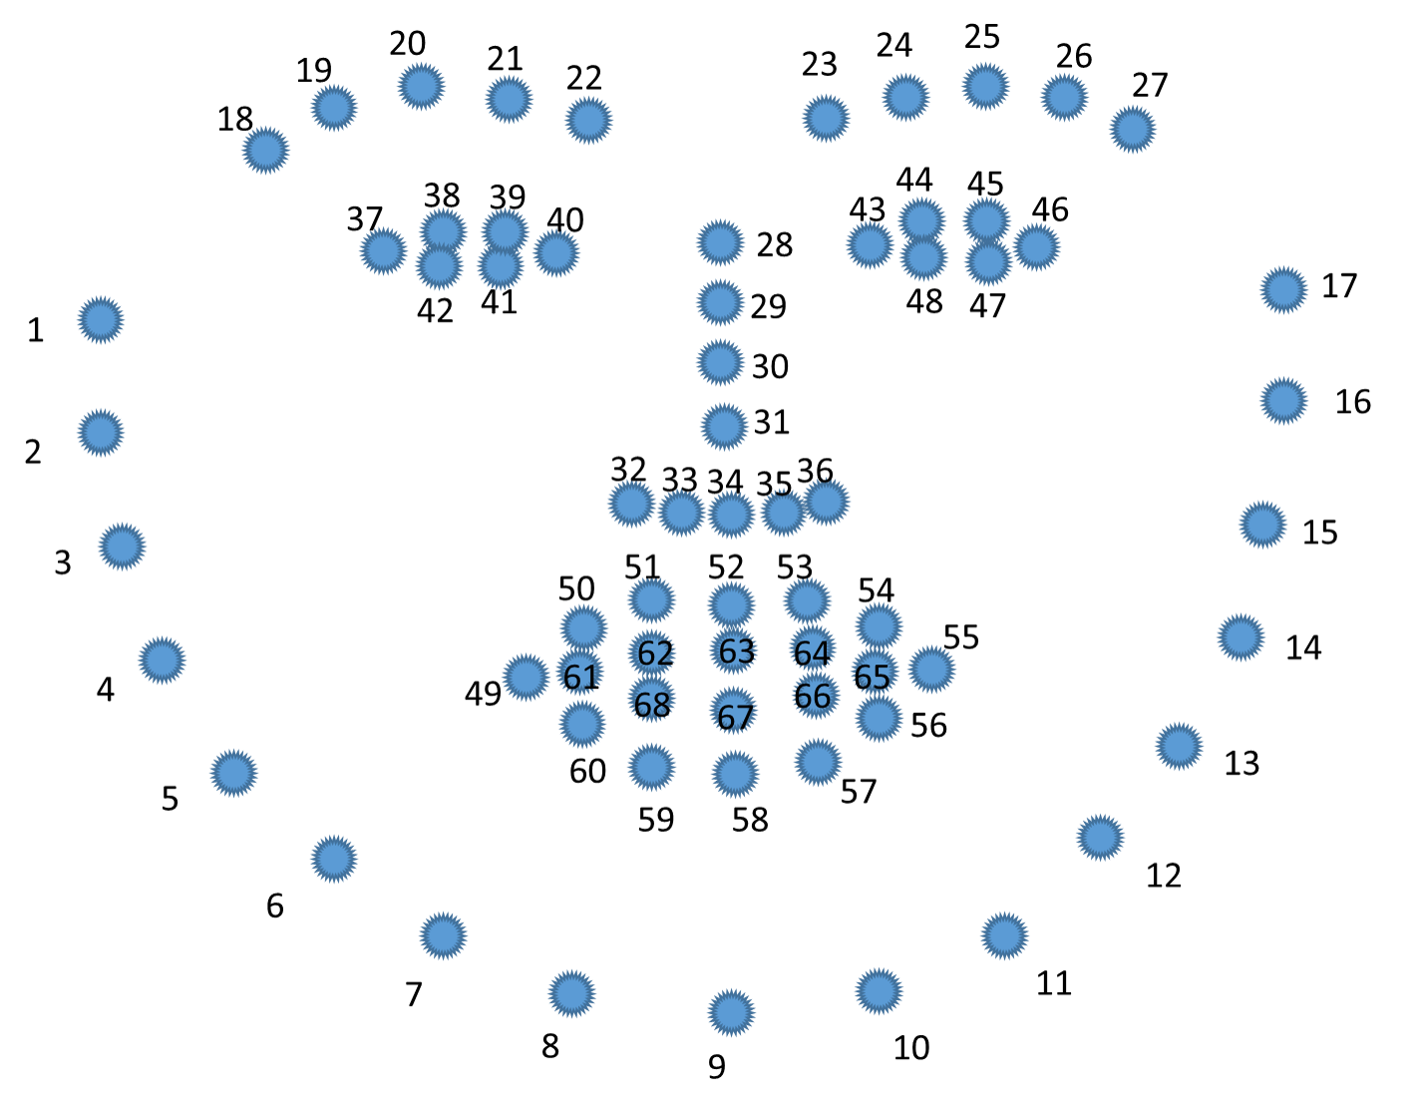
Facial Landmarks-
Facial landmarks are used for localizing and representing salient regions or facial parts of the person’s face, such as:
Facial Landmarks Detection has 2 steps:
It involves localizing the face in the image.
To detect the key facial structures on the person’s face.
DLIB-
The facial landmark detector which is pre-trained inside the dlib library of python for detecting landmarks, is used to estimate the location of 68 points or (x, y) coordinates which map to the facial structures. These indexes of 68 coordinates or points can be easily visualized on the image below:

Slide 9
Examining the image, we can see that facial regions can be accessed via simple Python indexing
The mouth can be accessed through points [48, 68].
The right eyebrow through points [17, 22].
The left eyebrow through points [22, 27].
The right eye using [36, 42].
The left eye with [42, 48].
The nose using [27, 35].
And the jaw via [0, 17].
These mappings are encoded inside the FACIAL_LANDMARKS_IDXS dictionary inside face_utils of the imutils library.

Slide 10
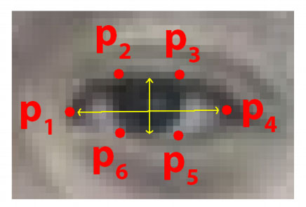
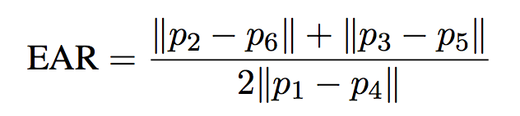
def eye_aspect_ratio(eye):
A = dist.euclidean(eye[1], eye[5])
B = dist.euclidean(eye[2], eye[4])
C = dist.euclidean(eye[0], eye[3])
ear = (A + B) / (2.0 * C)
return ear
def final_ear(shape):
(lStart, lEnd) = face_utils.FACIAL_LANDMARKS_IDXS["left_eye"]
(rStart, rEnd) = face_utils.FACIAL_LANDMARKS_IDXS["right_eye"]
leftEye = shape[lStart:lEnd]
rightEye = shape[rStart:rEnd]
leftEAR = eye_aspect_ratio(leftEye)
rightEAR = eye_aspect_ratio(rightEye)
ear = (leftEAR + rightEAR) / 2.0
return (ear, leftEye, rightEye)
Eye Closure Calculation-
Each eye is represented by 6 (x, y)-coordinates, starting at the left-corner of the eye (as if you were looking at the person), and then working clockwise around the eye:
Eye Aspect Ratio-

Slide 11
Results :
The subject is placed in front of the camera so that the face is in focus. The window displays the plotted landmarks, yawn count and a message of the subject’s state. It is expected that An alarm will be sounded when the yawn count exceeds the set boundary parameter. Alarm is also sounded if the eyes are found to be closed. When the subject found distracted then message along with an alarm being activated.
Notes:
The subject is placed in front of the camera so that the face is in focus. The window displays the plotted landmarks, yawn count and a message of the subject’s state. It is expected that An alarm will be sounded when the yawn count exceeds the set boundary parameter. Alarm is also sounded if the eyes are found to be closed. When the subject found distracted then message along with an alarm being activated.

Slide 12
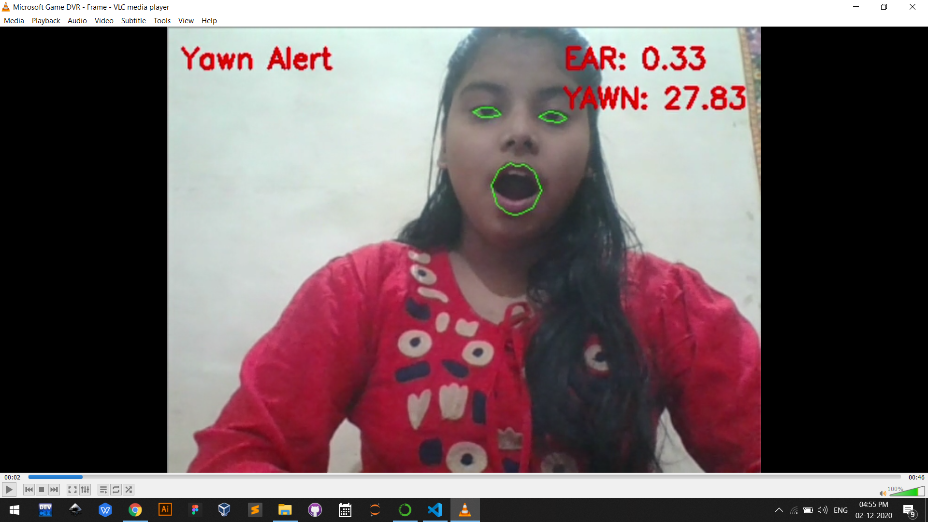
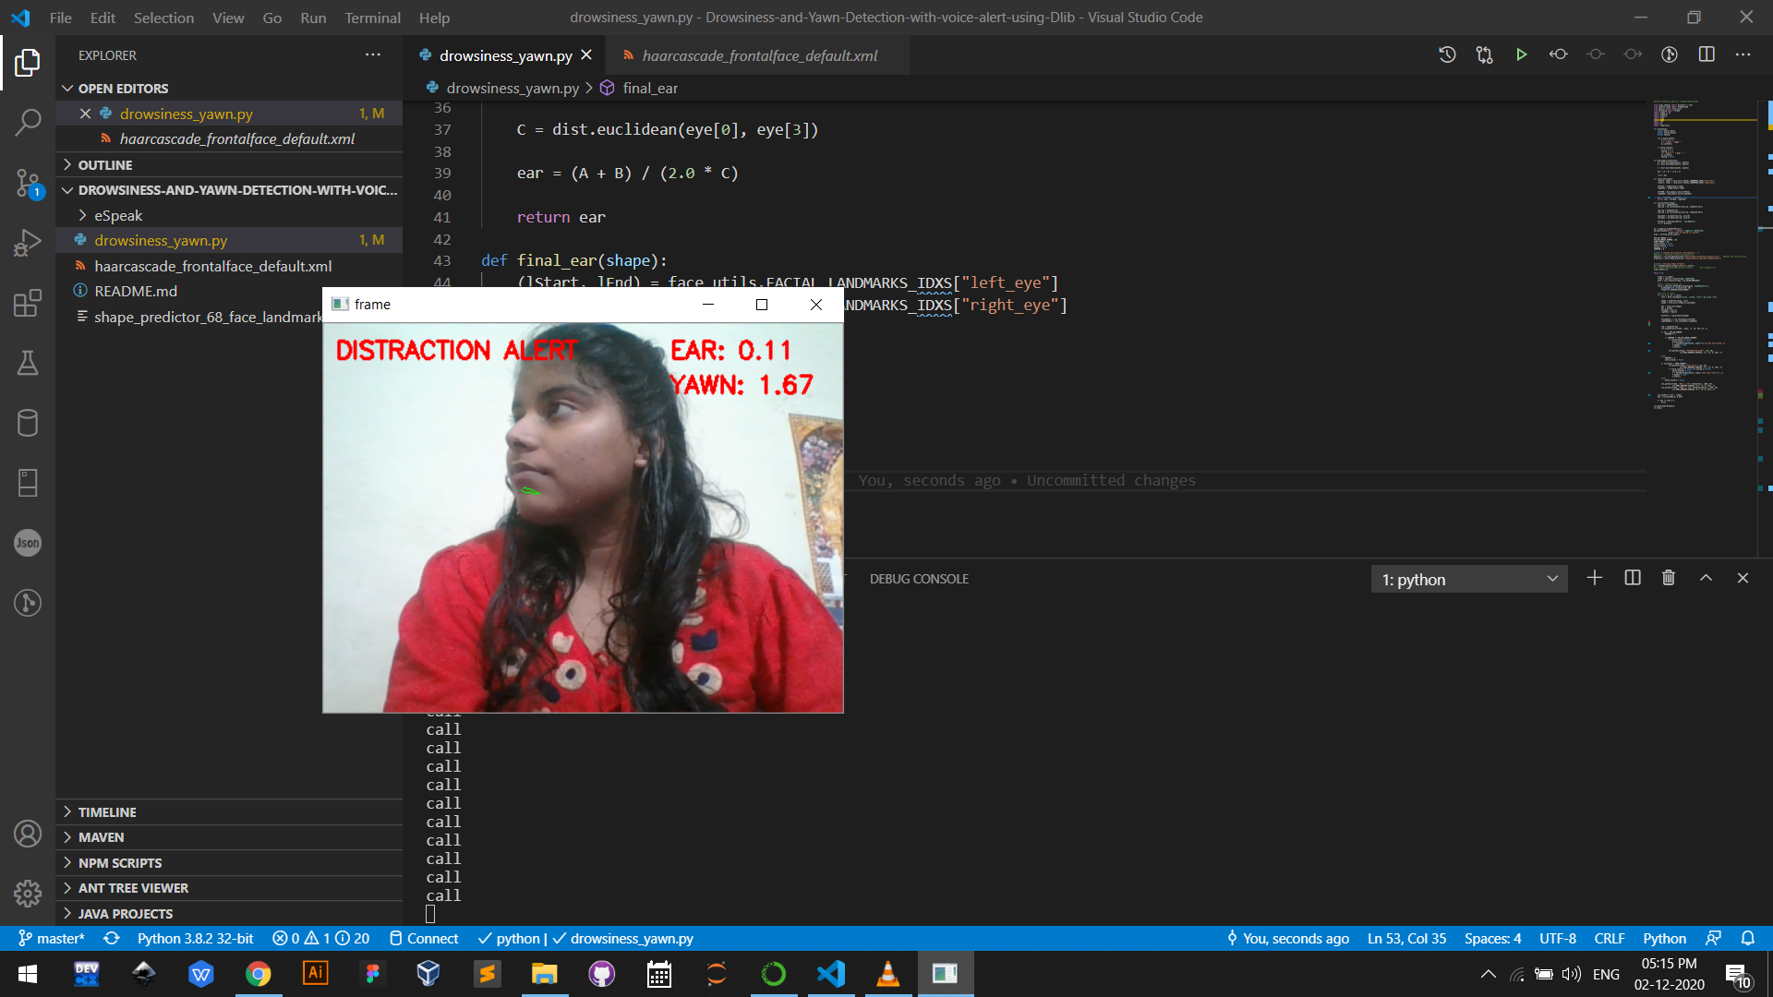
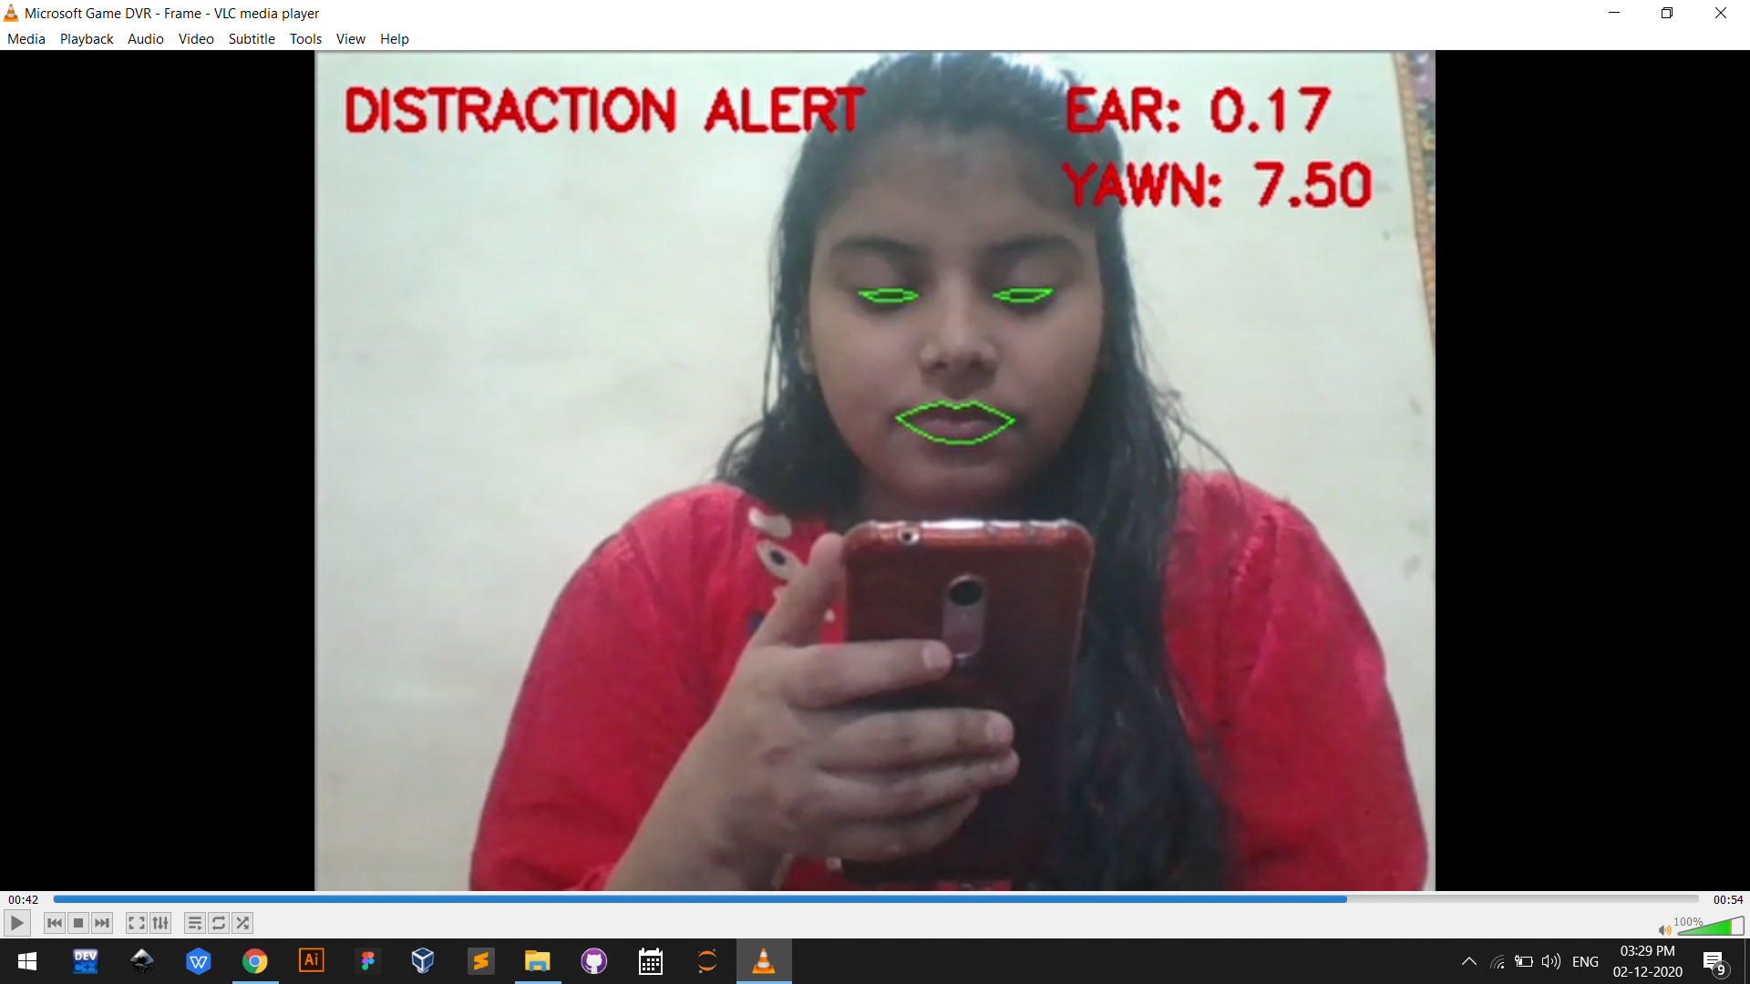
Saakshi
distraction

Slide 13
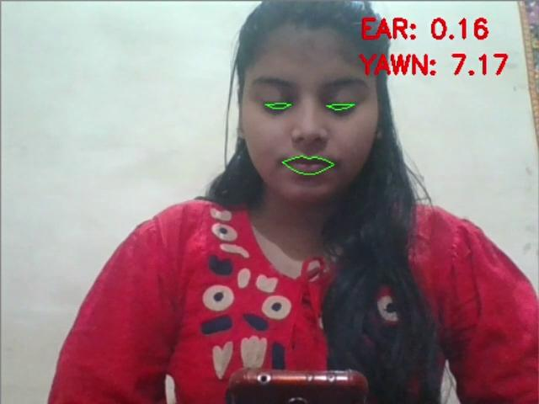
Notes:
Now I want to play video which shows the live demo of this system.

Slide 14
THANKS!
Notes:
we will be detect and predict 68 points in human faces using dlib’s pre trained model , This is trained on the ibug 300-W dataset.
Convex hull: Hull means the exterior or the shape of the object. Therefore, the Convex Hull of a shape or a group of points is a tight fitting convex boundary around the points or the shape. The Convex Hull of the two shapes in Figure 1 is shown in Figure 2. The Convex Hull of a convex object is simply its boundary.
Argparse:- The argparse module makes it easy to write user-friendly command-line interfaces. It parses the defined arguments from the sys. argv . The argparse module also automatically generates help and usage messages, and issues errors when users give the program invalid arguments.
SubProcess:- The subprocess module allows us to spawn processes, connect to their input/output/error pipes, and obtain their return codes.Subprocess intends to replace several other, older modules and functions, like: os.system commands. With subprocess one can suppress the output, which is very handy when we want to run a system call but are not interested about the standard output.

